Slide 1
Team Values Review
Spring 2026

Slide 2
Team Values Review
Workshop Overview
Group Brainstorming Board
Rethinking & Revising Team Values
Peer-to-peer Accountability
Defining Accountability Protocols
1
2
3
4

Slide 3
Group Brainstorming Board (5 min)
Teams of two: write 3 sticky notes for what works well and 3 for what doesn’t
Step 1: Split the board into two sections: "What Works Well in Teams" and "What Doesn't Work Well."
Write expectations or past experiences (positive or negative) on sticky notes (e.g., "Open communication," "No micromanaging").
Step 2: Cluster similar ideas and discuss:
What do we want to keep as a team?
How do we avoid what doesn’t work?
What Works Well in Teams? | What Doesn’t Work Well in Teams?

Slide 4
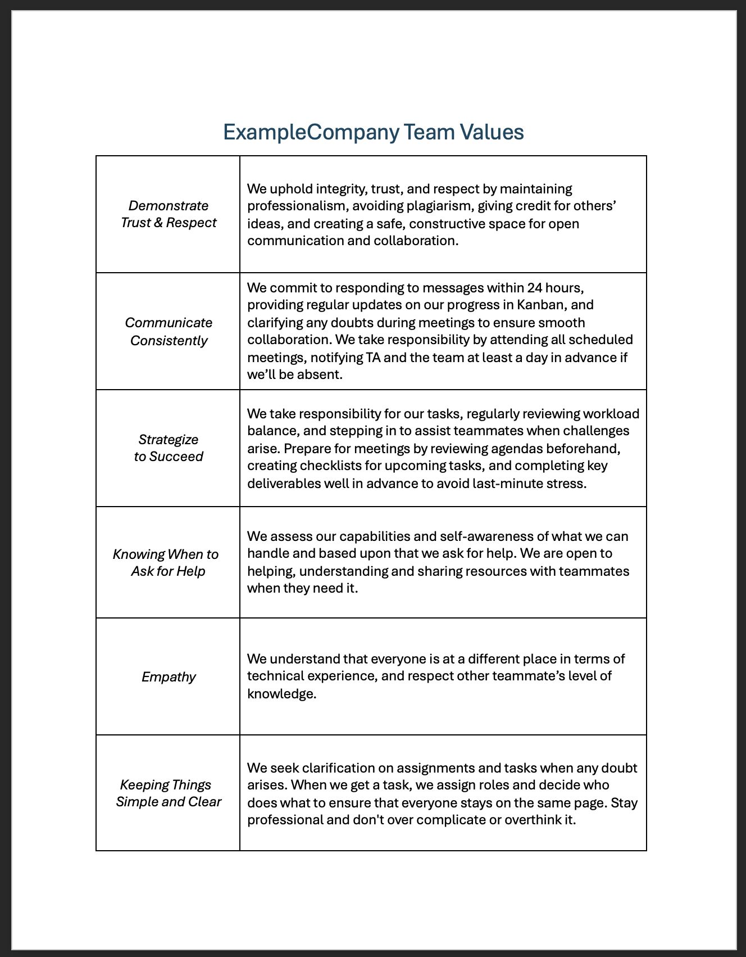
Team Values: Rethink & Revise (8 min)
What insights and patterns are revealed from team members' contributions to the brainstorming board?
How do these insights and patterns inform team values? What changes need to be made so each team’s values reflects their shared values?
Outcome: A shared “Updated Team Values”

Slide 5
Peer-to-peer Accountability (8 min)
Once team values are collaboratively established as part of the contract, it becomes a live document that serves as a safeguard and a reference point for the duration of the project.
Exploring accountability and hashing out its meaning in a team context can be tricky, but it's a critical part of the agreement and each member's understanding of roles and responsibilities (their own and others').
Try these discussion activities with your peers to prime their thinking about accountability and its role both in their everyday lives and in the context of the team.
Discussion Activity 1: (Teams of 2)
Discussion Activity 2: (Group)
In what ways have you had to be accountable?
Example: I have to pick up my little brother from baseball practice on Tuesday evenings.
Example: I have a big exam coming up so I need to make a schedule so I can study 30 minutes per day.
As a group, how do you define accountability? Think about the common themes from what everyone shared in the previous discussion.
Example: By picking my brother up from baseball practice, I have to be dependable. I would define accountability as being someone who is dependable.
Tip: During these activities, notice how words and phrases shared out loud develop into common themes. Consider having students code/mind map the key terms that emerge during the larger discussion.

Slide 6
Defining Accountability Protocols
Agree on measures to take to ensure team member accountability
Start by writing ideas on sticky notes
Accountability Protocols
Then, transfer protocols from sticky notes to a secondary document in the contract
What do we do if someone is not holding themselves accountable per each value?*
Work collaboratively to develop actionable steps to follow if a team member does not meet their target metrics (reminder messages, role reassignment, etc.).
Outcome: A shared set of “Accountability Protocols” ​
*Remember that you can always consult your Data Mine colleagues for guidance.

Slide 7
Thank You
Purdue OWL
Student Center 203
Web: https://owl.purdue.edu/
Phone: (765) 494-3723
Email: indy.owl@purdue.edu

