Slide 1
3MT PPT Initiation
Insights, Expectations, and Initiation
Spring 2026

Slide 2
Agenda
3MT Purpose
3MT Critique Insights
3MT Expectations
3MT PPT Initiation
1
2
3
4

Slide 3
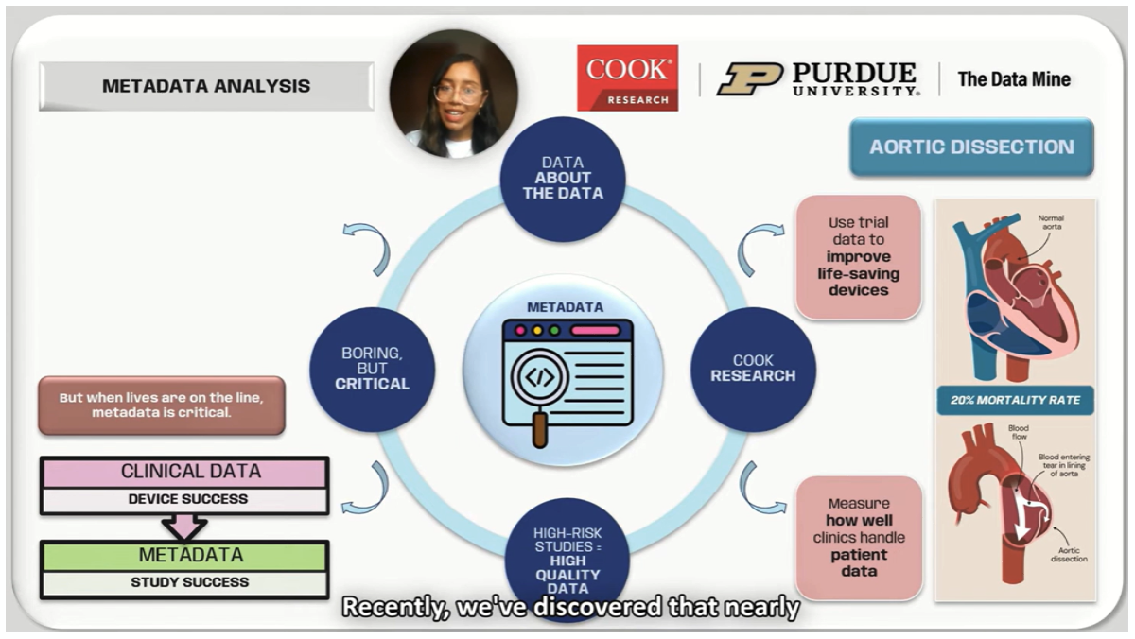
3MT Purpose
Why do we create a 3MT?

Slide 4
3MT Critique Insights
Categories | What to replicate | What to avoid
1. Content Clarity
2. Logical Flow
3. Project Relevance & Impact
4. Engagement
5. Slide Design
6. Delivery
7. ADA Closed Caption
8. Duration
Pair Discussion based on PD 10
Team 1
Team 2
Step 1: Individual recall
Recall/check the feedback you wrote in PD 10 for both videos
Step 2: Pair discussion
Which parts of the 3MT were clear and effective, that should be replicated?
Which parts were confusing, weak, or distracting that should be avoided?
Step 3: Share insights specific to categories
2 notes what to replicate
2 notes what to avoid
Team 1
Team 1
Team 2
Team 2
Team 1
Team 2

Slide 5
3MT Expectations
Categories | 3MT Expectation
1. Content Clarity
2. Logical Flow
3. Project Relevance & Impact
4. Engagement
5. Slide Design
6. Delivery
7. ADA Closed Caption
8. Duration
Team Discussion (by category)
Team 1
Team 2
Team 3
Review notes within each category
If notes conflict, agree on the approach you will take as a team
If a category has no notes, agree on expectations for this category of your 3MT (replicate/avoid)
Convert 3MT Expectations board into a file and save it in your MS Teams Channel
Team 3
Team 1
Team 4
Entire Team
Team 1
Team 2
Team 3
Team 3
Team 4
Team 2
Team 4
Team 4
Team 1
Team 2
Entire Team
5

Slide 6


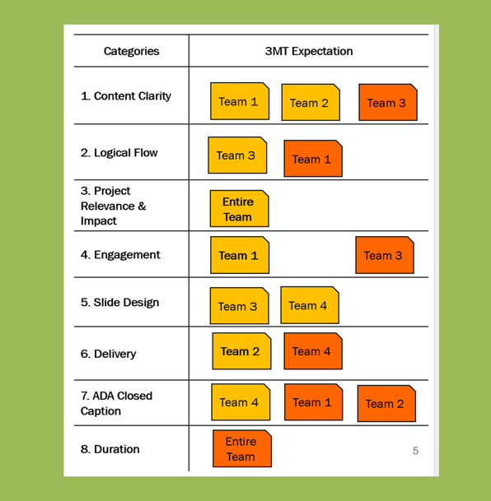
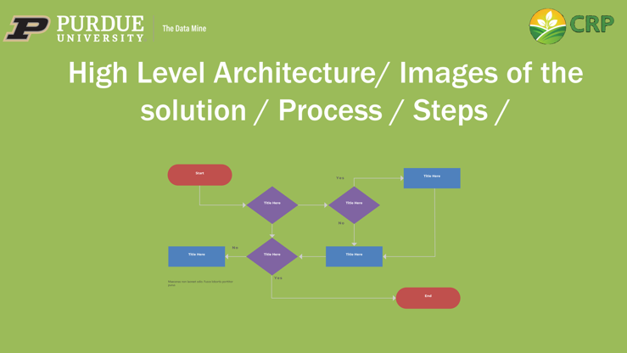

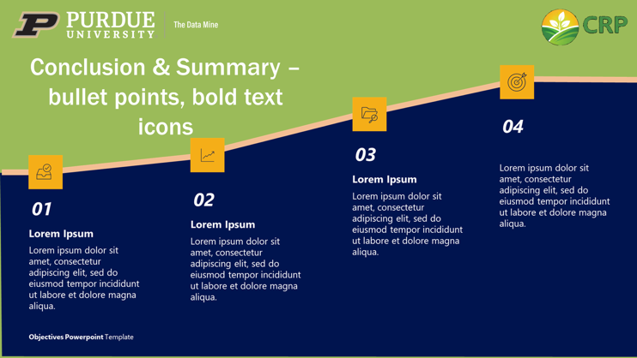
Our 3MT PPT Initiation
Deliverables - TA submits on your behalf by 03/06/2026
3MT PPT initiation
CRP branding colors
3MT title and logos
Rough slide layouts with clear placeholders (editable)
Save 3MT PPT in your MS Teams Channel.
The Team 3MT Expectations screenshot for reference
Note: Script and recording for 3MT PPT initiation are not required
The 3MT PPT visual shown for reference. It is not a template to copy.
6

Slide 7
Thank You

